Slide 1
Five Design Sheet
VADDE PAVAN KUMAR
29772990

Slide 2
NTR Arogya Seva:
Introduction:
scheme started by the Government of Andhra Pradesh, India
Where lakhs of people are getting benefited by the scheme .
Motivation:
In daily life, we see lot of people in and around will be dying with out
proper medication for the diseases which treatment costs high.
Outline:
Government is sponsoring the people who are in need and help that to based
On the financial status of the person and coming from the rural background.
That helps lot of poor and unhealthy people can get world class treatment and can live longer and happy life.

Slide 3
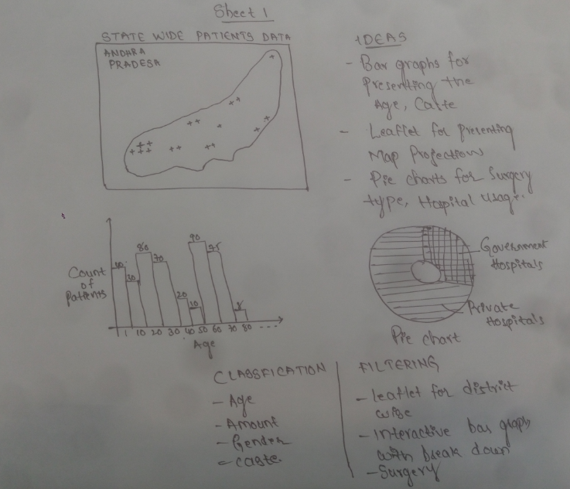

Slide 4
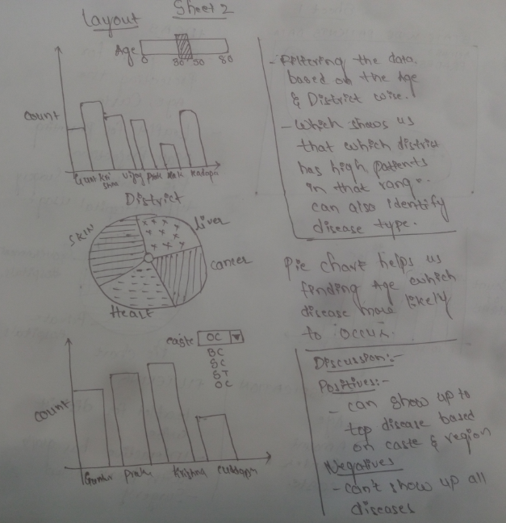

Slide 5
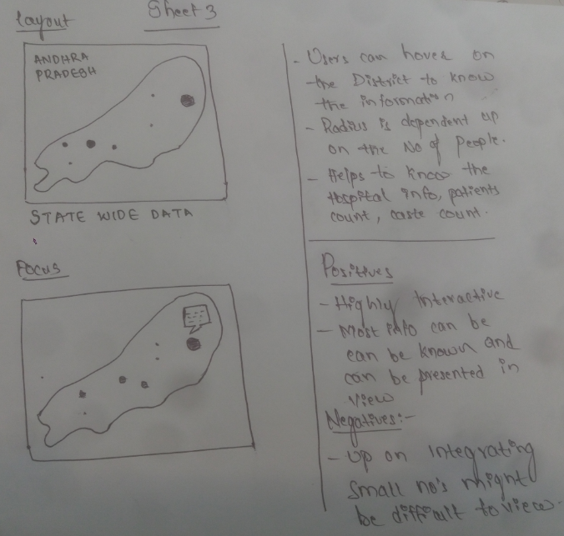

Slide 6
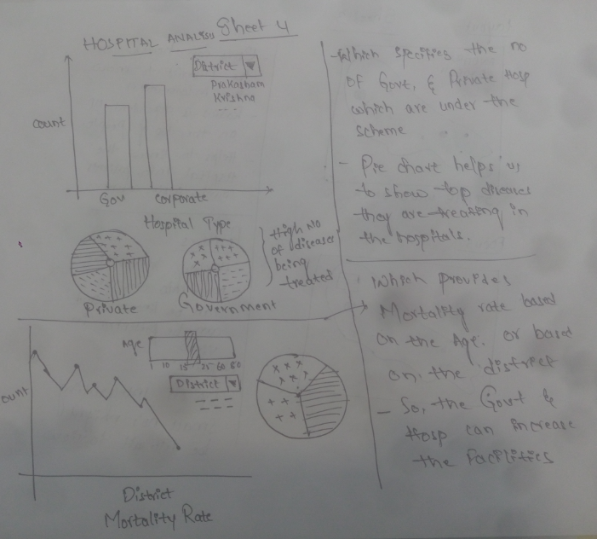

Slide 7
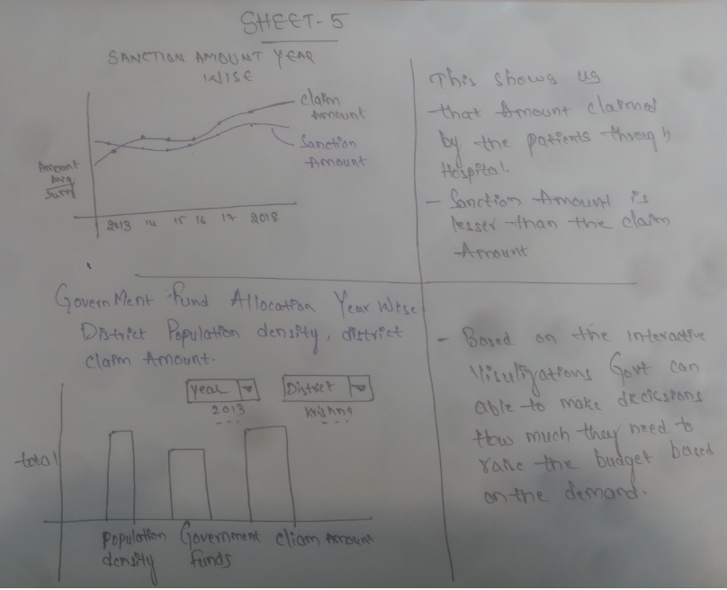

Slide 8


